Slide 1

Northeastern University - Seattle
CS6650 Building Scalable Distributed Systems
Vishal Rajpal

Slide 2
Week 4 – Distributed Systems Fundamentals
Topics we will cover today:
Network Communications Basics
Remote Procedure Calls
Distributed Coordination
Time in distributed systems

Slide 3
Network Communications Basics
Scaling a system involves adding multiple independently moving parts
Software runs on multiple machines.
Databases store data on multiple storage nodes.
Scalable software solutions are
Distributed across multiple nodes in multiple locations.
Each node processes events concurrently.
Nodes exchanging messages over a network.
Notes:
To scale a distributed system.
The components of a software are running on multiple machines and databases across multiple storage nodes.
And our solutions are distributed across multiple machines in multiple locations which each machine processing events concurrently and exchanging messages over a network.
This very nature of a distributed system has some implications on the way a distributed system is designed and built.

Slide 4
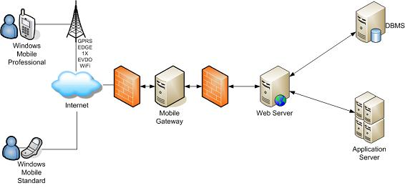
Network Communications Basics
Every distributed system has software components that communicate over a network. E.g.:
A cell phone app sends a request over the cellular network addressed to a bank to retrieve bank balance
Request is routed across the internet to the bank’s web server.
Bank’s web server authenticates the request (checks it’s you) and sends a request to a database server for balance.
Database server reads bank balance from disk and returns it to the web server.
Web server sends balance in a reply message to the app, which is routed over the internet and the cellular network.
Balance appears on your mobile device.

Slide 5
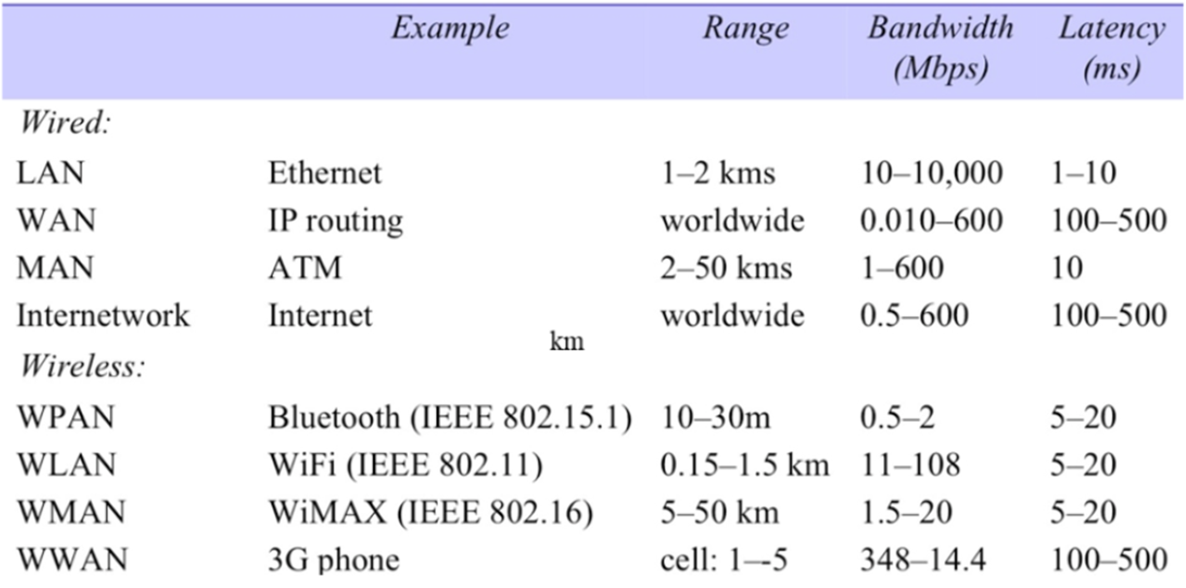
Network Communications Basics
Internet consists of many different types of networks
Notes:
The software component which retrieves the bank balance traverse multiple networking technologies and devices.
The global internet comprises of different types of network communication channels and devices which transmit millions of messages.
Two different and very obvious categorization of communication channels is wired and wireless.
They each have different characteristics and we will look most importantly into speed and range
For wired, there are LANs and WANs.
LANs are networks that can connect devices at in a range of 1-2 Kilometers.

Slide 6
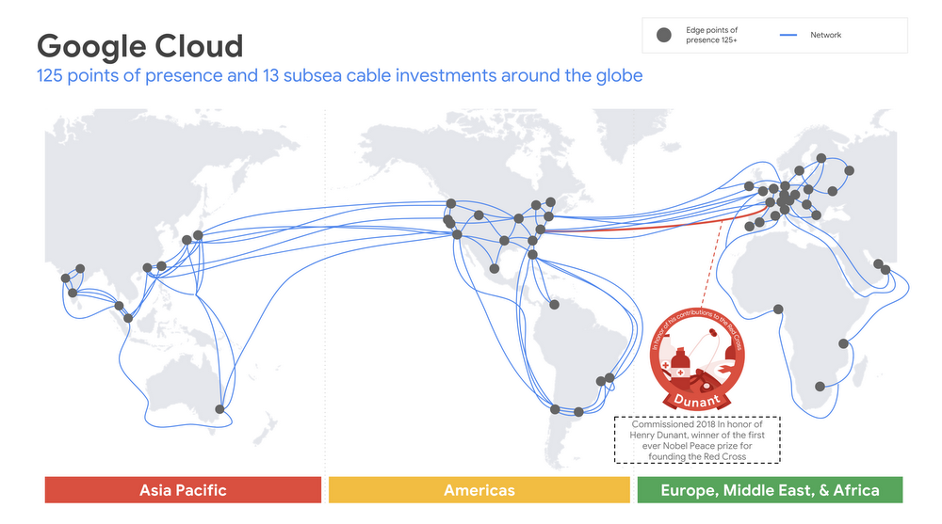
Network Communications Basics
Wide Area Networks (WANs)
WANs traverse the globe
High speed data ‘pipelines’ connecting continents with fiber optic cables.
Cables support a networking technology known as wavelength division multiplexing
Transmit up 171 Gbps over 400 channels, giving
~70 Terabits per second (Tbps) of bandwidth for a single fiber link.
Cables comprise four or more strands of fiber, giving bandwidth capacity of hundreds of Tbps for each cable.
Notes:
WANs are networks that we basically call Internet.
These long distance networks are high speed data pipelines connecting cities, countries and continents with fiber optic cables.
These cables support a networking technology known as wavelength division multiplexing making it possible to transmit up to 171 Gbps over 400 different channels, giving more than 70 terabits per second (Tbps) of total bandwidth for a single fiber link.
Wavelength Division Multiplexing allows to communicate bidirectional on a single fiber by using different wavelengths.
Each cable can comprise of 4 or more strands of fiber, giving a bandwidth of hundreds of Tbps for each cable.

Slide 7
Network Communications Basics
WAN Latencies
Notes:
WANs have higher latency but they also transmit data over hundreds and thousands of kilometers.
The maximum speed the data can travel in these fiber optic cables is close to speed of light.

Slide 8
Network Communications Basics
WAN Routers
Internet routers transmit data across the physical network connections from source to destination.
Specialized, high speed devices that can handle several hundred Gbps of network traffic
pulling data off incoming connections
sending data out to different outgoing network connections based on their destination.
Core internet routers comprise racks devices
Can process 10s to hundreds of Tbps.
Notes:
Actual time it takes for the data to travel through these cables will be slower as the data needs to pass through routers.
Routers are responsible to transmit data from source to destination.
Routers are specialized high speed devices that can handle several hundred Gbps of network traffic.

Slide 9
Network Communications Basics
Wireless Networking - Wifi
Wi-Fi protocol, 802.11ac, allows for maximum (theoretical) data rates of up to 5,400Mbps.
The most recent 802.11ax protocol, promises increased throughput speeds of up to 9.6Gbps.
Range of Wi-Fi routers is of the order of 10’s of meters, affected by physical impediments
Notes:
- Wireless technologies have different range and bandwidth characteristics.
WiFi routers (common in our homes and offices) are wireless Ethernet networks and use 802.11 to send and receive data.
802.11ax also known as WiFi 6.
The most widely used WiFi protocol 802.11ac allows for maximum data rates of up to 5400 Mbps.

Slide 10
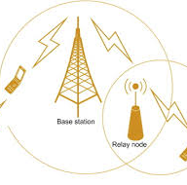
Network Communications Basics
Cellular Networks
Uses radio waves to send data from phones to routers mounted on cell towers, connected by wires to the core
4G LTE is 10 times faster than 3G,
download speeds around 10 Mbps (peak download speeds are nearer 50 Mbps)
upload speeds between 2 and 5 Mbps.
5G cellular networks promise 10x bandwidth improvement over 4G
1-2 millisecond latencies between devices and cell towers, compared with 20-40 20-40 millisecond for 4G.
5G base station range operates at about 500m maximum, compared with 4G range of 10-15kms
Notes:
The most common technolology is 4g LTE wireless broadband. 4g is 10 times faster than 3G and is able to handle sustained download speeds of around 10 Mbps and upload speeds between 2 and 5 Mbps.
5G networks promise 10 times bandwidth improvements over 4G with 1-2 millisecond latencies between devices and cell towers. Whereas 4G are in 20-40 millisecond range.
The trade off however is range. 5G base station range operates at 400 meters maximum whereas 4G has a range of 10-15km.

Slide 11
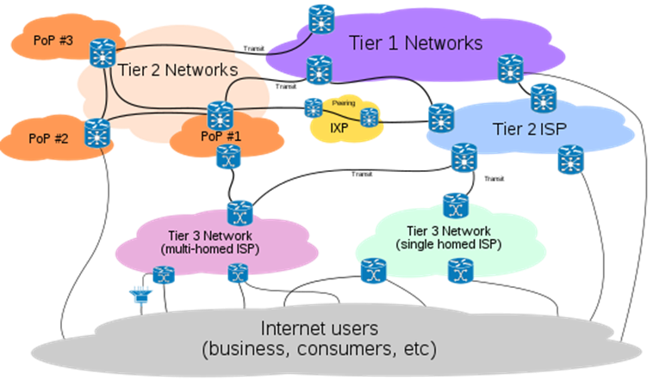
Network Communications Basics
The Internet
Notes:
- Tier 1 networks are global high-traffic internet backbone. There are around 20 Tier 1 ISPs which manage the global traffic.
- Tier 2 ISPs are regional for each country and have bandwidth lower than tier 1 ISPs
- Tier 2 ISPs deliver content through Tier 3 ISPs to which Customer pay their bills.

Slide 12
Network Communications Basics
Communications Software
Software systems on the internet communicate using the Internet Protocol suite.
The Internet Protocol suite specifies
Host addressing.
Data transmission formats.
Message routing and delivery characteristics.
Organized in 4 abstract layers
Notes:
From a distributed systems software perspective, we need to understand more about the what enables all this hardware to route messages from say a cell phone to a bank and back. This is where the Internet Protocol (IP) comes in.
- The 4 abstract layers contain related protocols that support functionality required at each layer.

Slide 13
Network Communications Basics
IP Suite Layers
Data link layer: specifies communications across a single network segment. Implemented by device drivers and network cards inside nodes
Internet (IP) layer: specifies addressing and routing protocols for traffic to traverse the independently managed networks that comprise the internet.
Transport (TCP, UDP) layer: specifies protocols for reliable and best-effort host-to-host communications.
Application layer: specifies application level protocols such as HTTP and SCP
Notes:
Each of the higher-layer protocols builds on the features of the lower layers. In the following section, we will briefly cover IP for host discovery and message routing, and TCP and UDP that can be utilized by distributed applications.
Data link layer – The data link layer protocols operate within a local network connection to which the host is connected to without traversing a router.
IP Layer – Routes packets across multiple networks which essentially establishes the Internet.
Transport layer – provides host-to-host communications for reliable transmission.
Application layer – protocols at application layer are used by applications for providing user services or exchanging application data over the network connections established by lower level protocols.

Slide 14
Network Communications Basics
Internet Protocol (IP)
IP defines
how hosts are assigned addresses on the internet and
how messages transmitted between two hosts who know each other’s addresses.
Every device has its own Internet Protocol (IP) address.
The location of an IP address stored in a directory service known as Domain Naming Service (DNS).
DNS is a widely distributed, hierarchical database
the address book of the internet.
Notes:
Ipv4 – 32 bit addressing scheme which we might run out of ip addresses due to the number of devices.
Ipv6 is a 128 bit addressing scheme which basically provides infinite number of devices.

Slide 15
Network Communications Basics
DNS Lookup
Notes:
DNS servers are organized hierarchically.
A small number of root DNS servers, which are highly replicated, are the starting point for resolving an IP address.
When an internet browser tries to find a website, a network host known as the local DNS server (managed by your employer or ISP) will contact a root DNS server with the requested hostname.
The root server replies with a referral to an authoritative DNS server that manages name resolution for, in the banking example, .com addresses.
There is an authoritative name server for each top-level internet domain (.com, .org, .net, etc.).
Next, the local DNS server will query the .com DNS server, which will reply with the address of the DNS server that knows about all the IP addresses managed by mybank.com. This DNS is queried, and it returns the actual IP address we need to communicate with the application.

Slide 16
Network Communications Basics
IP Message Delivery
IP delivers data from the source to destination host based on the IP addresses in the packet headers.
IP packet structure
data to be delivered
header data including source and destination IP addresses.
Data sent by an application is broken up into packets which are independently transmitted across the Internet.
Notes:
Demo amazon.com

Slide 17
Network Communications Basics
IP Packet Switching
IP is a best-effort delivery protocol. Doesn’t recover from transmission errors such as:
Data corruption
Packet loss
Duplication
Every packet is routed from source to destination independently
Results in out-of-order delivery to the receiver
Allows network to dynamically respond to conditions such as link failure and congestion
Hence IP is unreliable.
Notes:
Packet switching- routing of individual addressed packets.
Because of this design, the IP is unreliable. If two hosts require reliable data transmission, they need to add additional features to make this occur. This is where the next layer in the IP protocol suite, the transport layer, enters the scene.

Slide 18
Network Communications Basics
Transmission Control Protocol (TCP)
Application communications is achieved using Transmission Control Protocol (TCP) or User Datagram Protocol (UDP),
standard transport protocols for the IP network stack.
APIs for both TCP and UDP are widely available in mainstream programming languages
Use of these APIs not common as higher-level programming abstractions and protocols hide the details from most applications.
HTTP
WebSockets etc.
Notes:
TCP is by far most widely utilized.

Slide 19
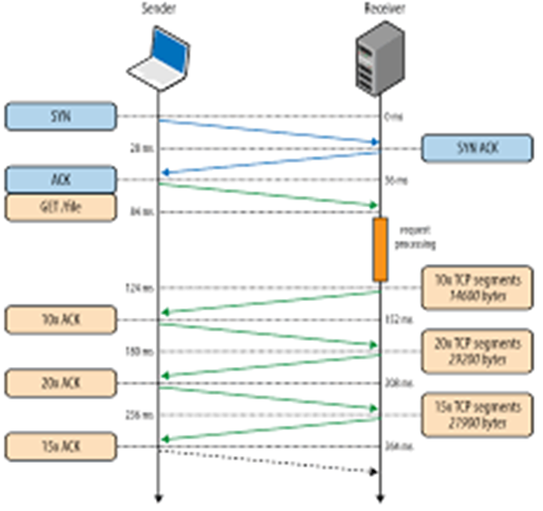
Network Communications Basics
Transmission Control Protocol
TCP is:
connection-oriented
stream-oriented
reliable
Uses a 3-step handshake to establish a two way connection between client and server
Data stream broken up into network packets for transmission
Each packet has source and destination address, used by the IP protocol to route the messages across the network.
Uses a sequence number so server can reassemble packets into a stream that is identical to the order they were sent.
Connection stays open until closed by client
Notes:
A stream of data is broken into individual packets with each packet size up to 64KB

Slide 20
Network Communications Basics
Transmission Control Protocol
TCP uses a cumulative acknowledgement mechanism for reliable delivery.
Receiver periodically sends an acknowledgement packet that contains the highest sequence number of received packets.
Implicitly acknowledges all packets sent with a lower sequence number.
If a sender doesn’t receive an acknowledgement within a timeout period, the packet is resent ➔ can lead to duplicates
TCP has many other features, e.g.
checksums to check packet integrity
dynamic flow control
TCP a relatively heavyweight protocol that trades off reliable over efficiency
Notes:
TCP is reliable as compared to IP.
These features make TCP a heavyweight protocol which is where UDP comes in.

Slide 21
Network Communications Basics
User Datagram Protocol (UDP)
Simple connectionless, unreliable protocol
No guarantee of (in order) delivery
No acknowledgements from server
Exposes the user's program to any unreliability of the underlying network.
Thin layer on top of the underlying IP protocol
trades off raw performance over reliability.
streaming audio, movies, video conferencing and gaming, are all UDP-appropriate applications
Notes:
Since UDP is connectionless, it exposes user’s program to unreliability of the underlying network.
In today’s systems one lost packet has very little effect. Example: Streaming, Gaming etc.

Slide 22
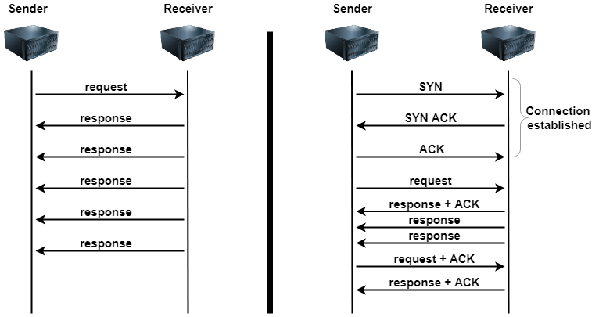
Network Communications Basics
Comparison
Notes:
The slide shows some of the major differences between TCP and UDP.
TCP incorporates a connection establishment three-packet handshake (SYN, SYN ACK, ACK), and piggybacks acknowledgments (ACK) of packets so that any packet loss can be handled by the protocol. There’s also a TCP connection close phase involving a four-way handshake that is not shown in the diagram.
UDP does not perform connection establishment, tear down, acknowledgments, and retries. Therefore, applications using UDP need to be tolerant of packet loss and client or server failures.

Slide 23
Remote Method Invocation
Distributed Communications
TCP sockets create a connection between a client and server which exchange data over that connection.
Client might request a balance for their checking account
{“balance”, “000169990”}
Server responds with account number and current balance
{“000169990”, “220.77”}

Slide 24
Remote Method Invocation
Application Protocol
Server will support many operations, e.g.:
“login”, “transfer”, “address”, “statement”, “transactions”, etc.
Each operation has a payload that the server processes to fulfill the client’s request.
We are defining an application specific protocol.
Application Protocol Interface (API)
// Simple mybank.com server interface
public interface MyBank {
public float balance (String accNo);
public boolean statement(String month) ;
// other operations
}
Notes:
Example MyBank interface in Java.
Each operation is a method and is passed an appropriate parameter list.
Advantages
-- Interface is clearly defined and simple.
Calls from Client to server can be checked by the compiler to endure they are of the correct format.

Slide 25
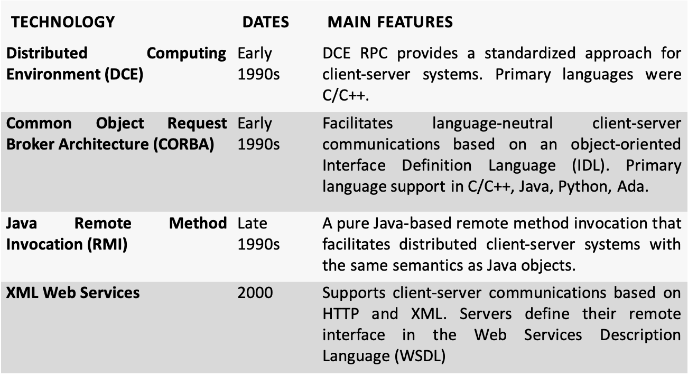
Remote Method Invocation (RMI)
Also known as Remote Procedure Call (RPC)
Notes:
- RMI technologies enable us to define explicit server interfaces and call these interfaces across the network essentially using the same syntax as we would in a normal program.

Slide 26
Remote Method Invocation
Java RMI Example
import java.rmi.*;
// Simple mybank.com server interface
Public interface MyBank extends Remote {
public float balance (String accNo) throws RemoteException;
public boolean statement(String month) throws RemoteException ;
// other operations
}
Notes:
Java offers a Remote Method Invocation (RMI) API for building client/server applications.
The java.rmi.Remote interface serves as a marker to inform the Java compiler we are creating an RMI server.
In addition, each method must throw java.rmi.RemoteException. These exceptions represent errors that can occur when a distributed call between two objects is invoked over a network. The most common reasons for such an exception would be a communications failure or the server object having crashed.

Slide 27
Remote Method Invocation
Java RMI Example
public class MyBankServer extends UnicastRemoteObject implements MyBank {
// constructor/method implementations omitted
public static void main(String args[]){
try {
MyBankServer server=new MyBankServer();
// create a registry in local JVM on default port
Registry registry = LocateRegistry.createRegistry(1099);
registry.bind("MyBankServer", server);
System.out.println("server ready");
} catch(Exception e){
// code omitted for brevity}
}
}
Notes:
We then must provide a class that implements this remote interface.
The server extends the UnicastRemoteObject class. This essentially provides the functionality to instantiate a remotely callable object.
Once the server object is constructed, its availability must be advertised to remote clients. This is achieved by storing a reference to the object in a system service known as the RMI registry, and associating a logical name with it.
The registry is a simple directory service that enables clients to look up the location (network address and object reference) of and obtain a reference to an RMI server by simply supplying the logical name it is associated with in the registry.

Slide 28
Remote Method Invocation
Java RMI Example – Client
// obtain a remote reference to the server
MyBank bankServer= (MyBank)Naming.lookup("rmi://localhost:1099/MyBankServer");
//now we can call the server
System.out.println(bankServer.balance("00169990"));
Notes:
Stub and Skeleton are compiler generated objects that felicitate remote communication in an RMI system.
Skeleton is a tcp network endpoint executing on a host and listening on a particular port.
When the server reference is stored in the RMI registry, the entry contains a stub that can be used to make calls to the remote server
When the client queries the registry the stub is what is returned which can be used to make calls to the server.
The stubs job is to translate the class into what can be passed across the network also known as marshalling.
Skeleton unmarshalls the request and calls the appropriate server

Slide 29
Remote Method Invocation
RMI/RPC Summary
Advantages:
Location transparency
Clear contract specification
Type-checking
Disadvantages:
Marshalling and Unmarshalling can become Inefficient
Tight coupling of client to server
Cross language marshalling and unmarshalling introduces complexity

Slide 30
Remote Method Invocation
HTTP API
Simpler
Efficient
Scalable
Notes:
For these reasons, most modern systems are built around simpler protocols based on HTTP and using JSON for parameter representation.
Instead of operation names, HTTP verbs (PUT, GET, POST, etc.) have associated semantics that are mapped to a specific URL.

Slide 31
Distributed Systems Issues
Partial Failures
Distributed applications communicate using an asynchronous network:
Nodes can choose to send data to other nodes at any time
Thee network is half-duplex, such that one node sends a request and must wait for a response from the other. These are two separate communications.
Time for data to be communicated between nodes is variable - network congestion, transient failures
Receiving node may not be available due to a machine crash or other reasons.
Data can be lost due to a variety of reasons.
Nodes do not have identical internal clocks, hence they are not synchronized.

Slide 32
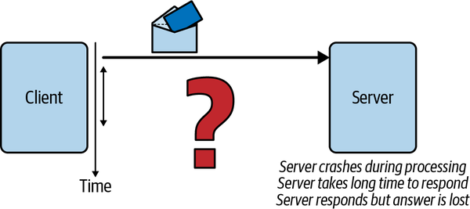
Distributed Systems Issues
Partial Failures
Notes:
When a client sends a request to a server, how long does it wait until it receives a reply? Is the server node just being slow? Is the network congested and the packet has been dropped by a router? If the client doesn’t get a reply, what should it do?
Let’s explore these scenarios in detail. The core problem here, namely whether and when a response is received, is known as handling partial failures,

Slide 33

Distributed Systems Issues
Partial Failures
The request succeeds and a rapid response is received.
The destination IP address lookup may fail. In this case the sender receives an error message.
The IP address is valid but the destination node or target server process has failed. Sender will receive an error message.
The request is received by the target server, which fails while processing the request and no response is ever sent.
The request is received by the target server, which is busy. It processes the request but takes a long time to respond
The request is received by the target server and a response is sent. However, the response is not received by the client due to a network failure.
Client
Insert $100 to Adam’s balance
Server
timeOut
Insert $100 to Adam’s balance
time
Notes:
When a client attempts to connect to a server and exchanges messages, the following outcomes may occur
- The typical solution that clients adopt to handle crash faults is to resend the request after a configured timeout period. However, this is dangerous.

Slide 34
Idempotence
Requests that make no persistent state changes are idempotent.
i.e. all read requests
Updates - clients send a unique idempotence-key in all requests that mutate state.
identifies a single operation from the specific client or event source.
Server checks if it has previously seen the idempotence key value by reading from a database for implementing idempotence.
If the key is not in the database, this is a new request.
performs the business logic
stores the idempotence key is in a database
If the idempotence key is in the database, server returns the results for the operation so that (hopefully) the client won’t retry.
Notes:
“a property of an operation that ensures that, if the operation is repeated once or more than once, you get the same result”

Slide 35
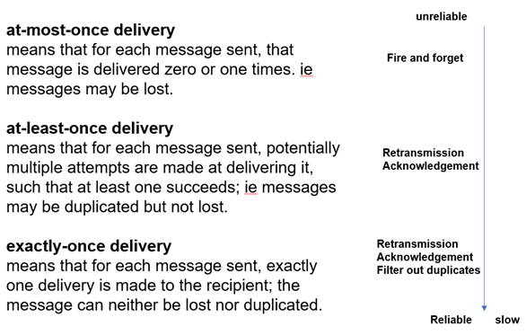
Idempotence
Idempotence key database:
A separate database table in the transactional database?
A dedicated database that provides very low latency lookups?
Idempotence key can be discarded after a TTL.
Idempotent API implementation must ensure that both the application state needs to be modified and idempotence key need to be stored.
Exactly Once Semantics
Idempotence = exactly once
Notes:
At most once delivery – UDP
At least once delivery - TCP

Slide 36

Consensus
Two Generals
https://www.youtube.com/watch?v=X7jzXlt6CgE
Notes:
With messengers being randomly captured or extinguished, there is no guarantee the two generals will ever reach consensus on the attack time. In fact, it can be proven that it is not possible to guarantee agreement will be reached. There are solutions that increase the likelihood of reaching consensus.
E.g. send 100 soldiers to increase probability.

Slide 37
Distributed Consensus
Two Generals is analogous to nodes in a distributed system reaching agreement on some state
Partial failures are analogous to losing messages and acknowledgements.
It can be demonstrated that consensus is impossible to achieve within bounded time
On an asynchronous network
In the presence of crash faults
Messages can be delayed but not lost

Slide 38
Distributed Consensus
This is known as the FLP Impossibility Theorem .
Michael J. Fischer, Nancy A. Lynch, and Michael S. Paterson. 1985. Impossibility of distributed consensus with one faulty process. J. ACM 32, 2 (April 1985), 374–382.
FLP is a worst-case scenario
not possible to guarantee consensus will be reached with unbounded message delays on an asynchronous network.
In reality distributed systems reach consensus every millisecond!!
can establish sensible practical bounds on message delays
retry after a timeout period.

Slide 39
Byzantine Failures
Imagine extending the Two Generals problem to
N Generals, who need to agree on a time to attack.
Traitorous messengers may change the value of the time of the attack
Traitorous general may send false information to other generals.
Malicious failures are known as Byzantine faults
Algorithms that address malicious behavior exist.
Blockchain technologies and BitCoin.

Slide 40
Time in Distributed Systems
Clocks on individual nodes drift due to environmental conditions
Drift values of 10-20 seconds a day are not uncommon.
A time server represents an accurate time source, such as a GPS or atomic clock
Can be used to reset the clock on a node to correct for drift on packet-switched, variable-latency data networks.
Notes:
Every node in a distributed system has its own internal clock. If all the clocks on every machine were perfectly synchronized, we could always simply compare the timestamps on events across nodes to determine the precise order they occurred in. If this were reality, many of the problems we will discuss with distributed systems would pretty much go away.

Slide 41
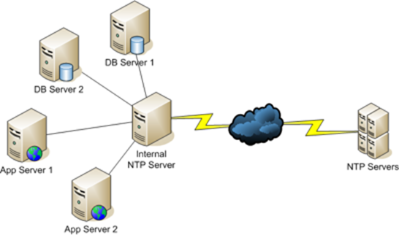
Network Time Protocol (NTP)
Node runs the NTP client to synchronize to a NTP server.
Time on a node is set by a UDP message exchange with one or more NTP servers.
Messages are timestamped time taken for transit is estimated.
On a LAN, machines can synchronize to an NTP server within a small number of milliseconds accuracy
Be careful – clocks may move backwards!!
Notes:
NTP
hierarchically organized collection of time servers spanning the globe
300 worldwide root servers
20000 servers on the second layer synchronized within a few milliseconds periodically and so on through out the hierarchy.
Maximum of 15 levels within the hierarchy
Globally 175K NTP servers available to synchronize to

Slide 42
CPU Clocks
Time of Day Clock
Number of milliseconds since midnight January 1970.
In Java, System.currentTimeMillis().
Can be reset by NTP, and hence may jump forwards or backwards
Monotonic Clock
Amount of time (in seconds and nanoseconds) since an unspecified point in the past, such as the last reboot
Only moves forward
May not be accurate as it stalls during events such as a virtual machine suspension
In Java, System.nanoTime().

Slide 43
Clock Synchronization
NTP – common for a node to synchronize in one hour to one day interval
Chrony – more accurate, scalable than NTP
E.g. used by Facebook
Amazon Time Sync Service
GPS/Atomic clocks in data centers
Clock synchronization is crucial whenever local timestamps from multiple machines need to be compared.

Slide 44
Summary
Communications in distributed systems traverse many different types of underlying physical networks
Communication latencies are highly variable
Communications can fail
TCP provides reliable connection-based communications
UDP provides unreliable datagram-based communications
RMI/RPC technologies build on TCP/IP sockets to provide abstractions for client-server communications
Achieving agreement, or consensus on state across multiple nodes is in theory impossible
In reality we can devise algorithms that achieve consensus in practice.
Clocks on individual nodes vary and cannot be used for meaningful comparisons. Need a time service for synchronization.

Slide 45
Questions?

